Slide 1
IMS Project
Jariful Hoque

Slide 2
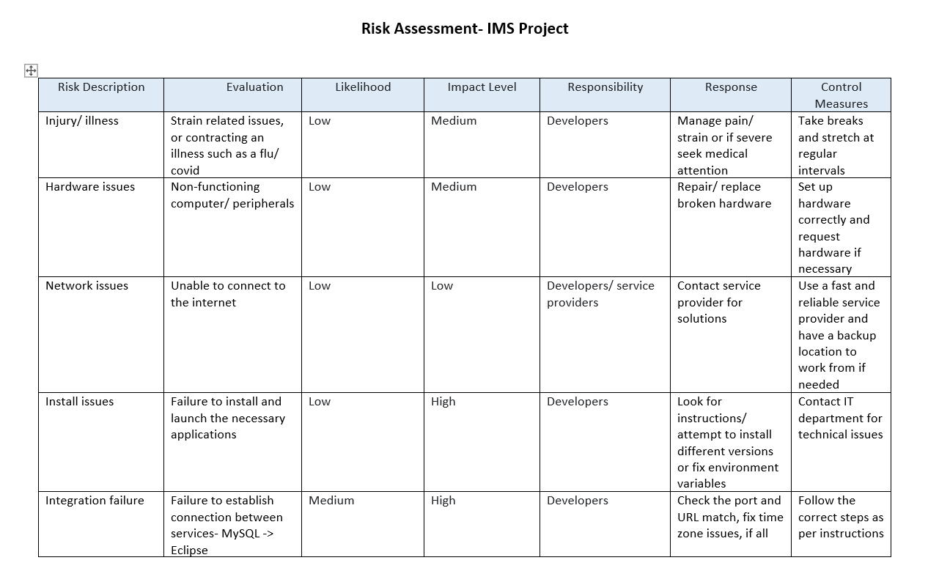
Planning

Slide 3
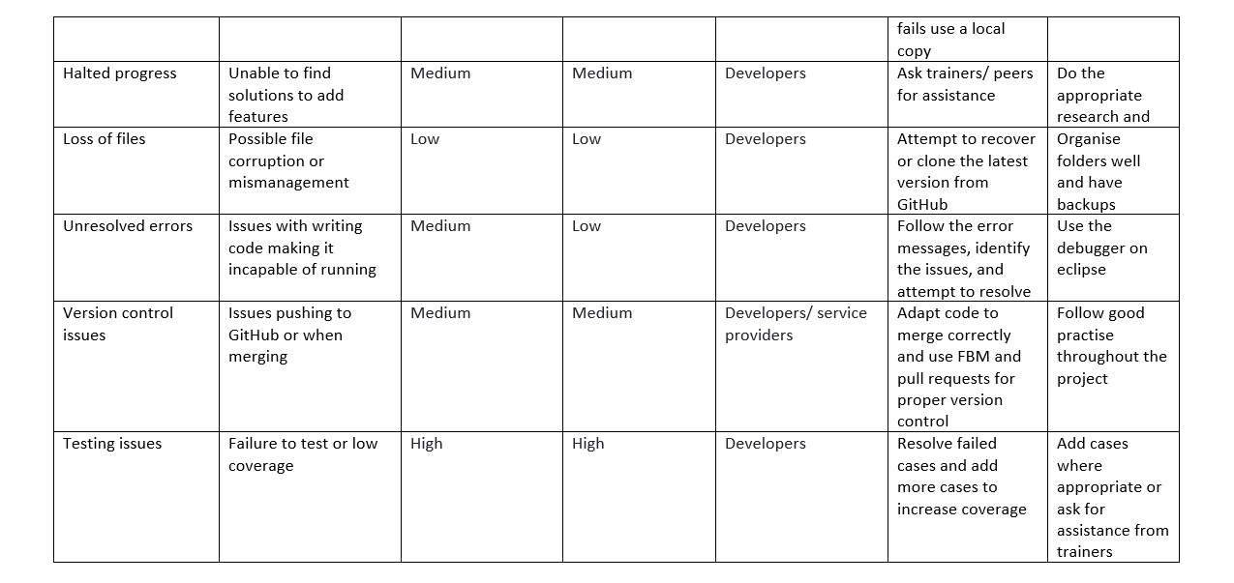
Planning

Slide 4
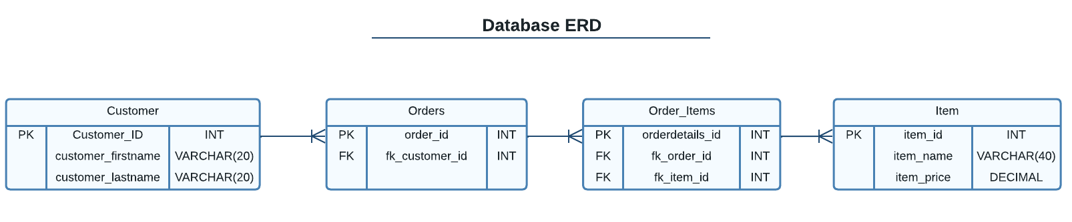
Planning

Slide 5
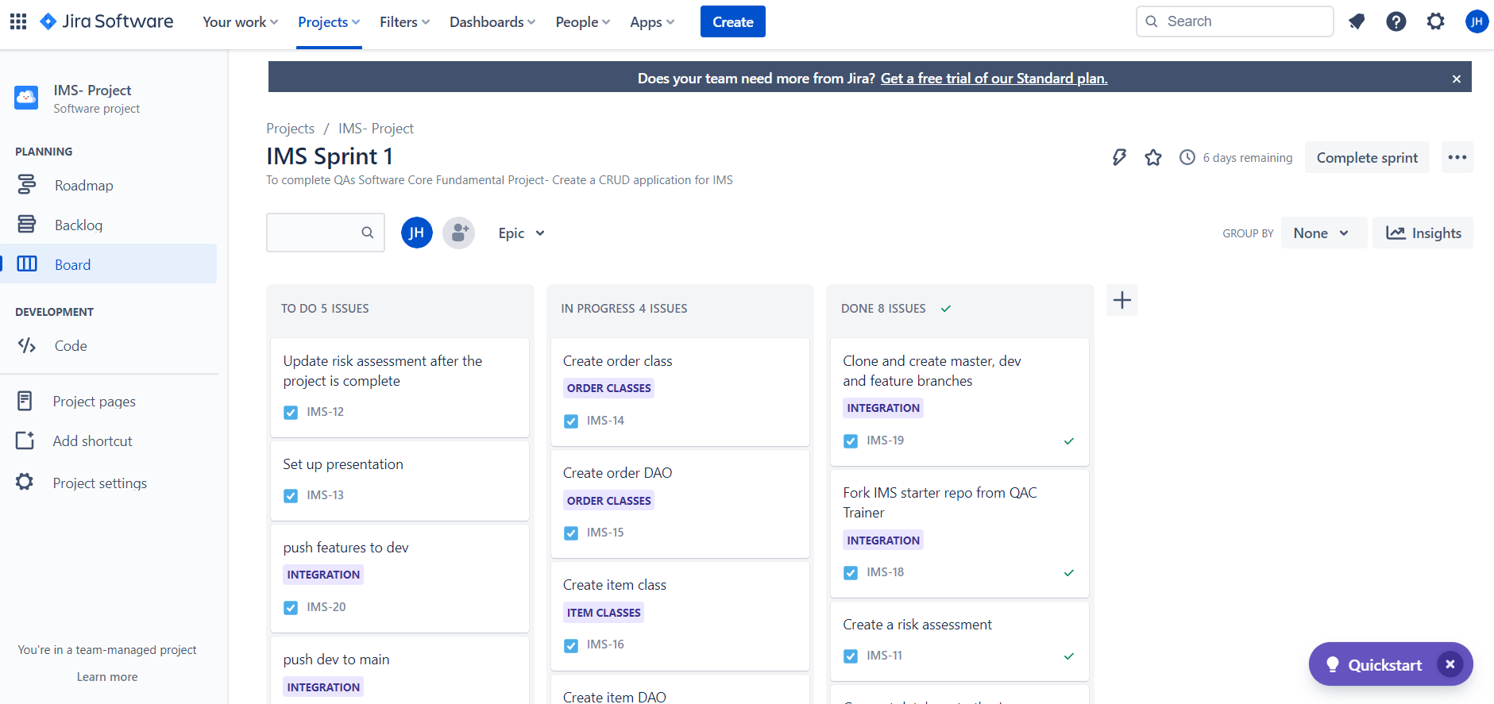
Agile

Slide 6
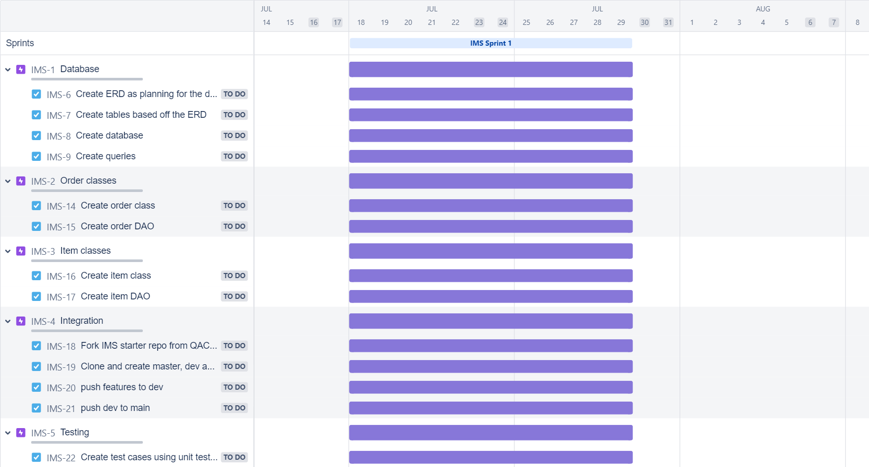
Agile

Slide 7
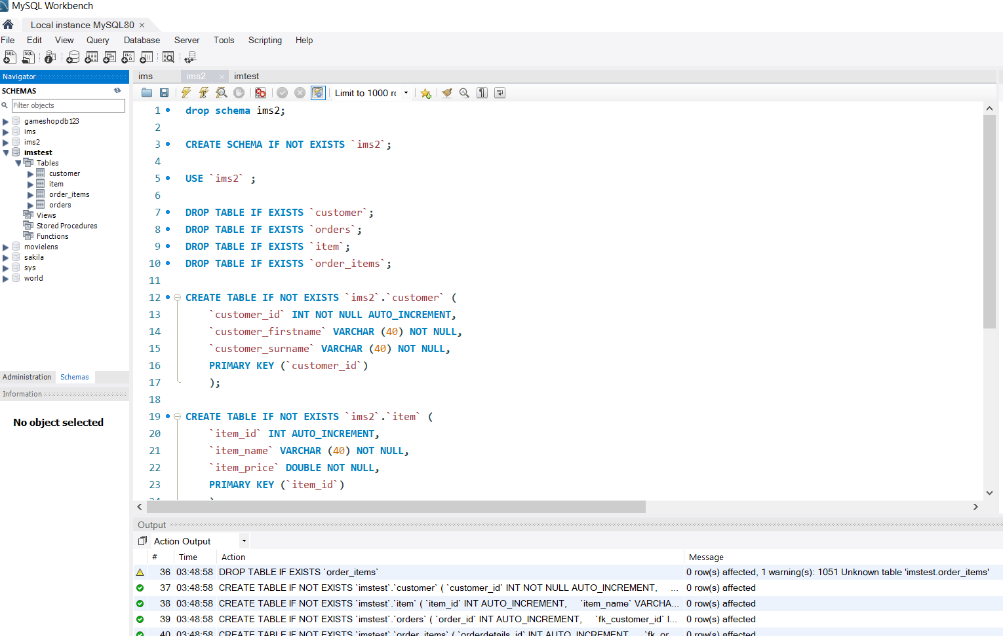
Database

Slide 8
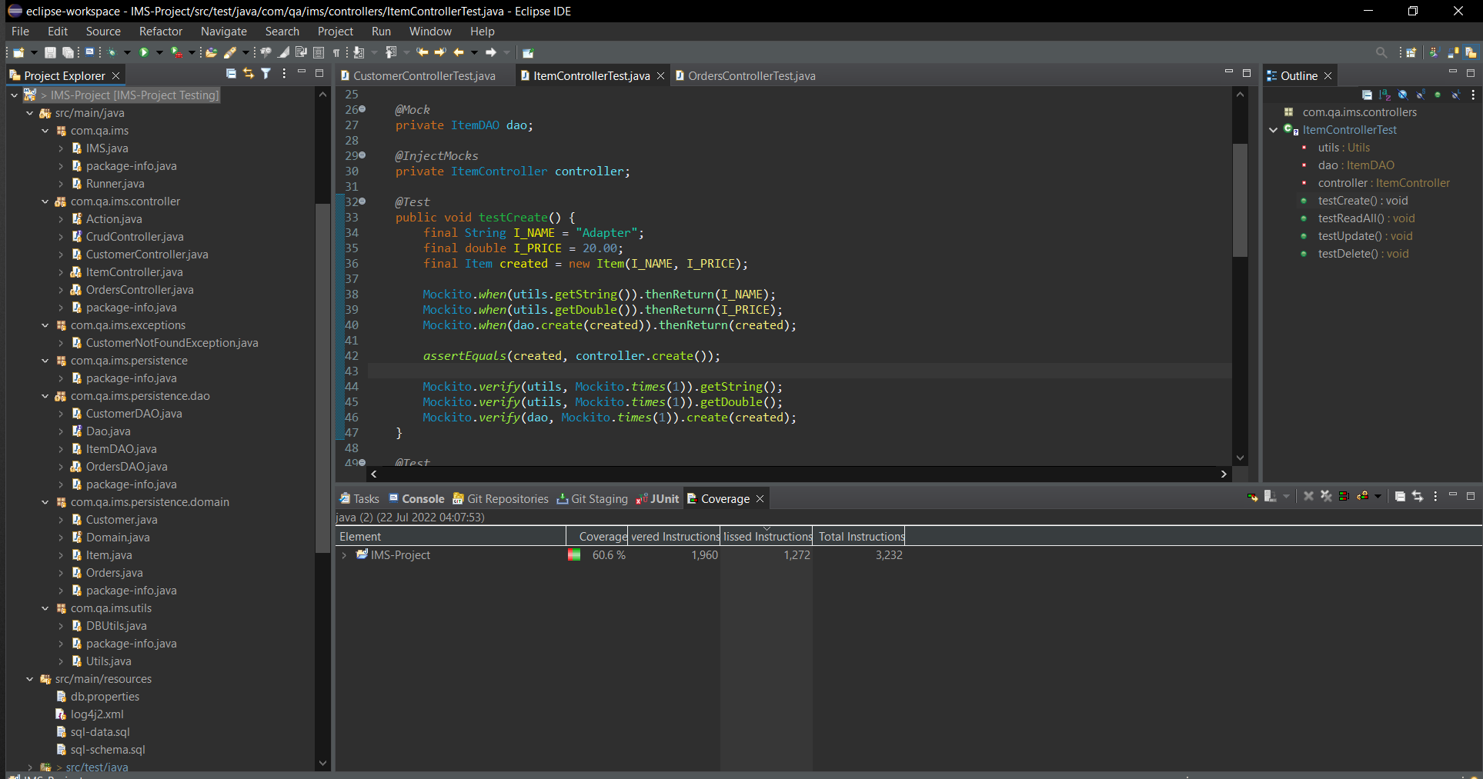
Development

Slide 9
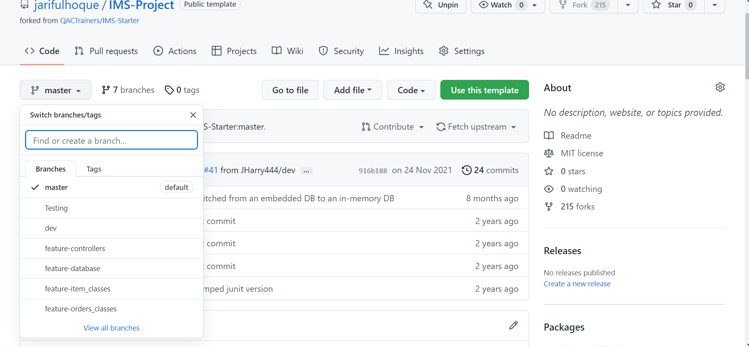
Version Control

Slide 10
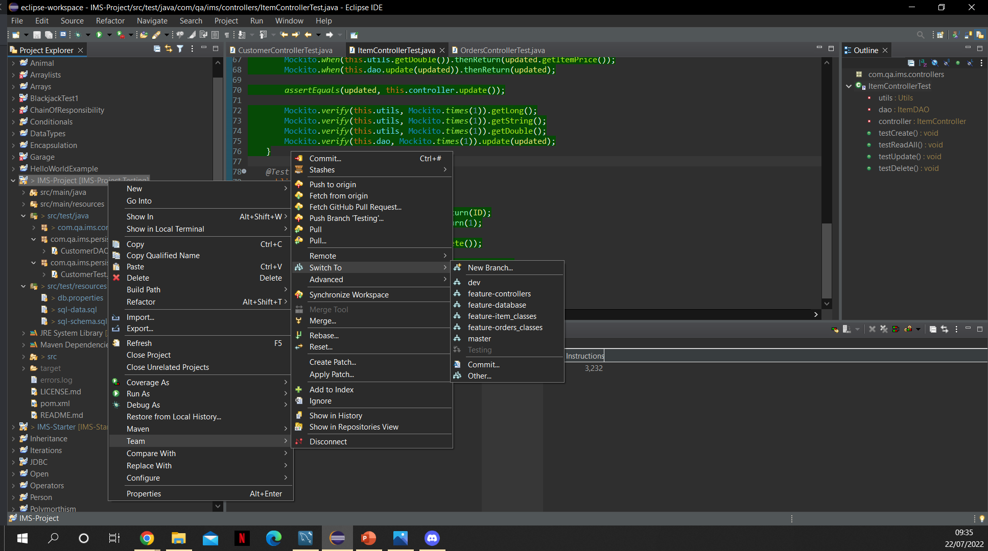
Version Control

Slide 11
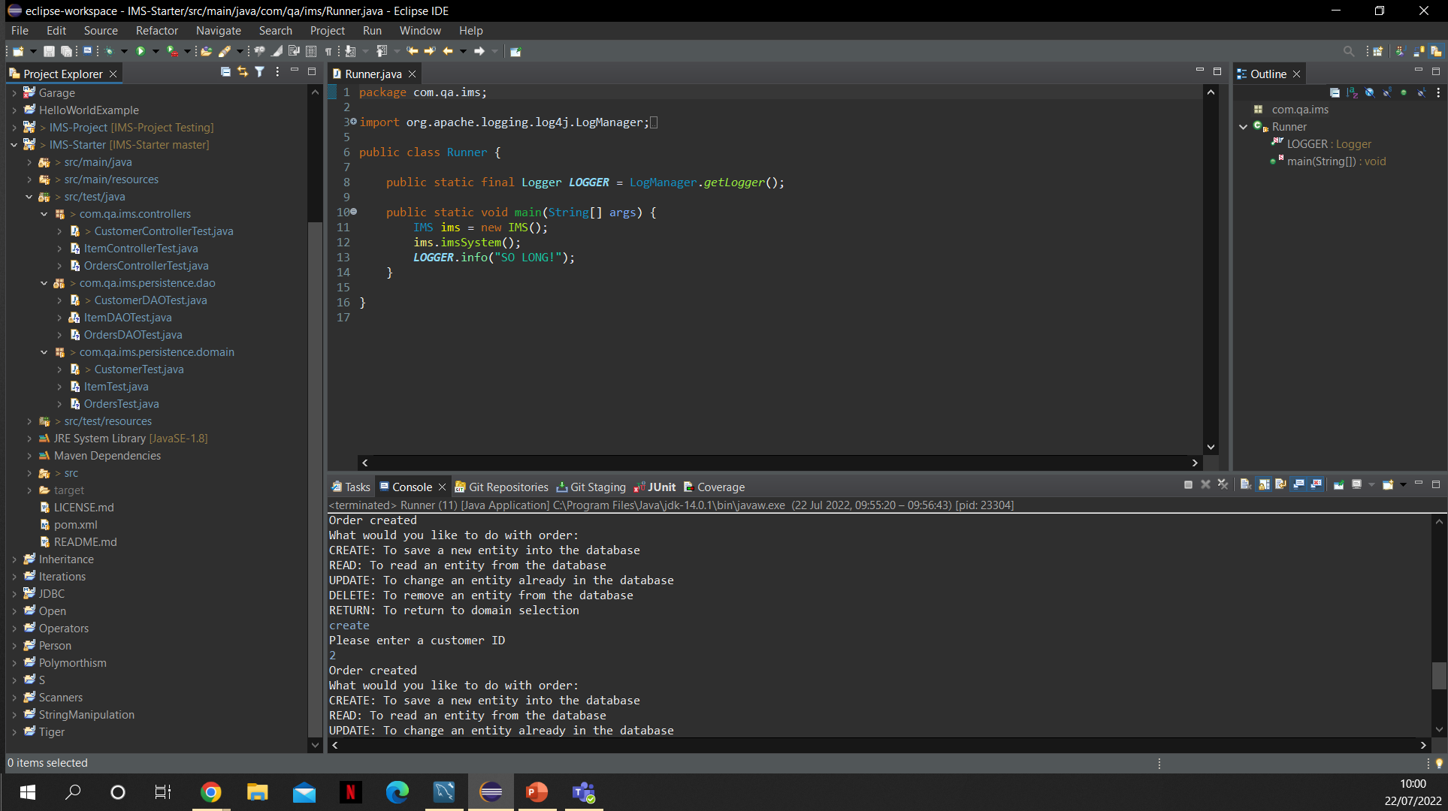
Testing

Slide 12
Tools Used
Java- Eclipse IDE
MySQL
Maven
Jira
Github

